Slide 1
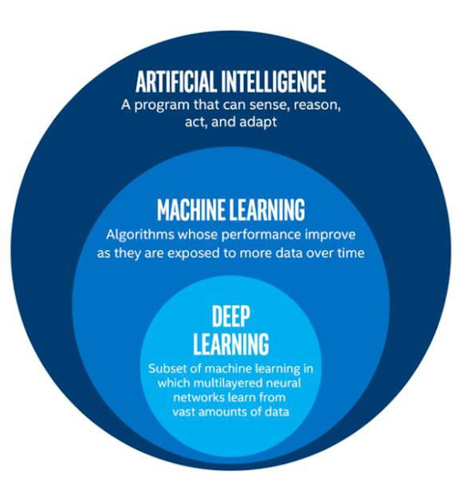
Artificial Intelligence & Data Science
Artificial Intelligence
Development of a smart computer system, able to perform task, normally require human intelligence such as Visual Perceptions, Speech Recognition, Decision Making & Language Translations
Development of a ‘Computer Program or Machine’ which can Learn, Think and Act by own
Learn : Acquire Data Think : Analysis Of Data Act : Taking Action

Slide 2
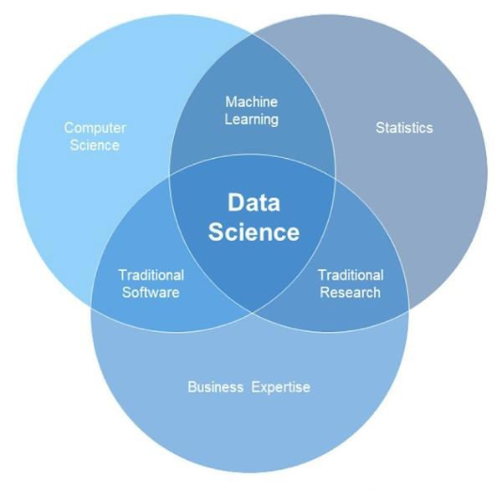
A broad view of Data Science
Machine Learning ( ML ) : Traditional Software ( TS ) : Traditional Research ( TR ) : Data Science ( DS ):
Applying statistics on computer Doing Business using computer
Use of statistics to understand , explain and grow business A Broad canvas that encompasses ML , TS & TR

Slide 3
Machine Learning
A Discipline under Data Science
Imparts and Empowers Machine to Learn , Think , Act for themselves
Help’s computers to learn from pattern’s & behavior and act accordingly without any human intervention or being explicitly programmed
ML Technology -
It uses Algorithms & Mathematical Models to analyze data and learn from it. For Ex - Following statistical models are used to analyze data
  Linear Regression
  Decision Trees
  Naïve Bayes’ Classification Model
Exploratory Data Analysis -
This is the first step in machine learning to be apply on data set
It deal with doing Descriptive and Inferential statistics on data set
Data Science
It is root of all
A discipline that utilize a combination of Mathematical , Statistical and Computational tools to acquire , process and analyze Big Data .
It help in impart meaning from large amount of Big Data
Data Scientist and Analyst uses –
  ‘Statistical Inference’ to extract hidden & useful patterns from large data sets
  And ‘Data Visualization’ techniques to communicate those insights into business oriented directions ( With Domain Expertise )
Processes used in DS -
Data Extraction
Data Cleaning
Data Analysis
Visualization of Data
Generalization of actionable insights

